Slide 1
Tadpole Marketplace Database Project
Database Design and Dashboard Review
Martin Lam, Mohitveer Kahlon

Slide 2
Database Design Goals
Support buyers and sellers
01
Track products and inventory
02
Manage orders and payments
03
Store product reviews
04

Slide 3
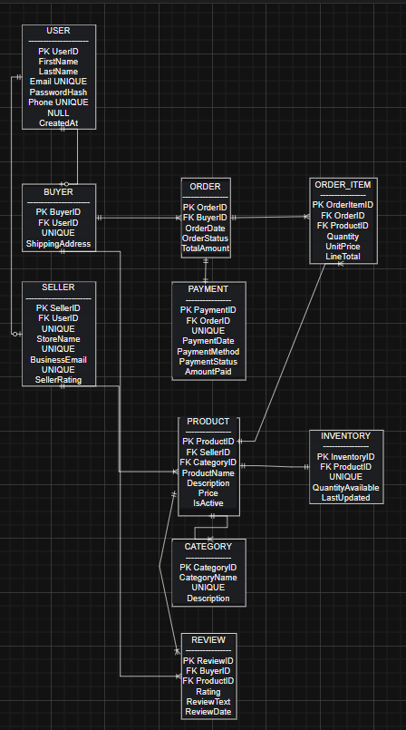
Final Entity Relationship Diagram (ERD)
10 tables
Normalized database design
Primary & foreign key relationships
Supports users, products, orders, inventory, payments, and reviews

Slide 4
Dashboard Overview
8 business visualizations
Inventory monitoring
Sales and category performance
Customer behavior insights

Slide 5
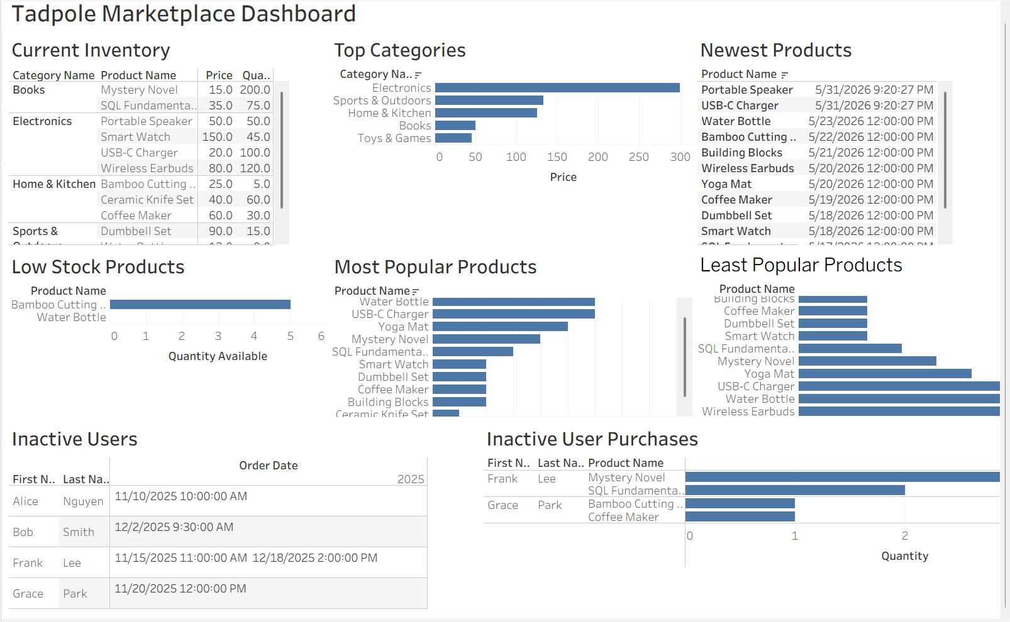

Slide 6
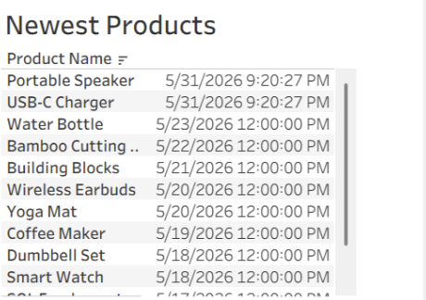
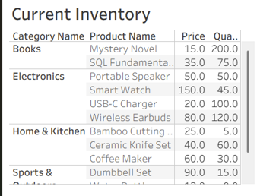
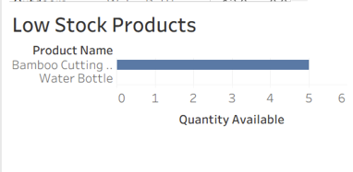
Inventory Management
View current inventory levels across all product categories
Identify products that require restocking
Track recently added or updated products
Support inventory planning and product management

Slide 7
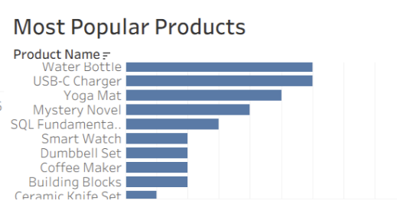
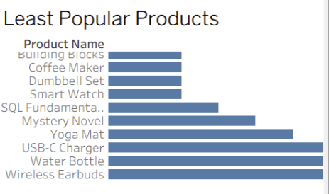
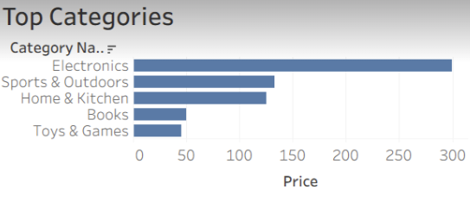
Sales Performance
Compare top-selling and low-selling products
Identify products driving the most sales
Evaluate category performance
Support sales and marketing decisions

Slide 8
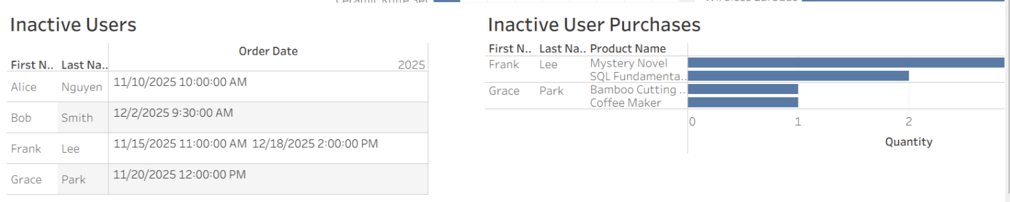
Customer Behavior
Identify customers who have not purchased recently
Review purchasing patterns of inactive users
Support customer retention efforts
Help target future promotions and outreach

